Slide 1
Creating Robot Mission Plans with Autonomous Vehicle Command Language (AVCL) IS3460 Mission Experimentation Projects
Don Brutzman
Naval Postgraduate School (NPS)
24 August 2022

Slide 2
Motivations are fundamental
Gain familiarity with current robotics capabilities and importance of field experimentation (FX)
Understand missions by human-machine teams
Ability to understand risks, implications of robot tasking regardless of C2 interfaces that you might use someday

Slide 3
Learning Objectives
Learn about Mission Representation using AVCL definitions
Mission examples: Coffee Search Retrieval, TCE22.2 MEMS test
Provide templates to create new AVCL missions
Define new useful robot missions for field experimentation (FX)
Human command and control (C2) of semi-autonomous robots

Slide 4
Mission Representation using Autonomous Vehicle Command Language (AVCL)
Structured vocabulary to define unmanned-system missions, understandable by human commanders, useful in multiple programming languages plus Semantic Web logical queries.

Slide 5
Autonomous Vehicle Command Language (AVCL)
AVCL is a command-and-control language (C2) for humans supervising autonomous unmanned vehicles.
Clarity arises from close correspondence to human naval terminology.
Structured vocabulary defining terms and relationships for mission planning, execution, conduct, recording and replay across diverse robot types.
Common-ground XML representations for
Mission agenda plans, mission scripts, and post-mission recorded telemetry results.
Operators have single archivable, validatable format for robot tasking, results
directly convertible to and from a wide variety of different robot command languages.
Future work: define unit tests, expected results for verification and validation.
Mission Tasking
https://savage.nps.edu/Savage/AuvWorkbench/AVCL/AVCL.html

Slide 6
Example AVCL mission agenda, as pseudo-code XML
<?xml version="1.0" encoding="UTF-8"?>
<UUVMission>
<GoalSet>
<Goal area=”A” id=”goal1”>
<Search nextOnSuccess=”goal2” nextOnFailure=”goal3”/>
</Goal>
<Goal area=”A” id=”goal2”>
<SampleEnvironment nextOnSuccess=”goal3”
nextOnFailure=”recover”/>
</Goal>
<Goal area=”B” id=”goal3”>
<Search nextOnSuccess=”goal4” nextOnFailure=”goal4”/>
</Goal>
<Goal area=”C” id=”goal4”>
<Rendezvous nextOnSuccess=”recover” nextOnFailure=”recover”/>
</Goal>
<Goal area=”recoveryPosition” id=”recover”>
<Transit nextOnSuccess=”missionComplete” nextOnFailure=”missionAbort”/>
</Goal>
</GoalSet>
</UUVMission>
AVCL is readable by human or robot,
captures logic of mission tasking
XML ensures syntactically correct, well-defined, numerically valid
Needed: semantic representation
to check ethical, logical consistency

Slide 7
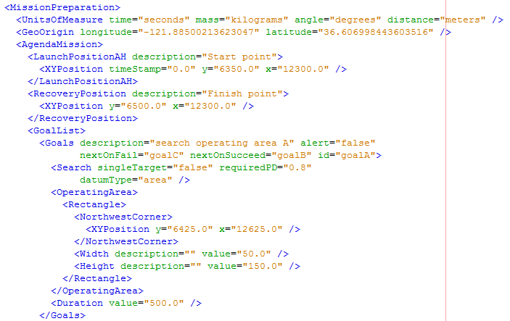
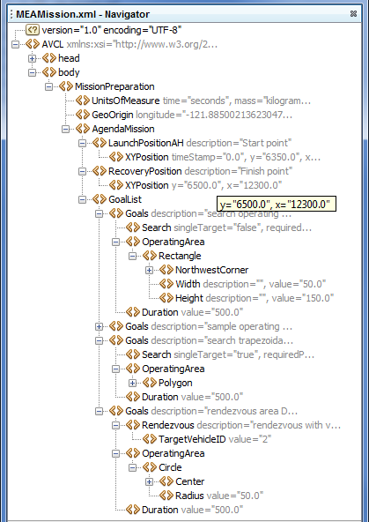
Corresponding example: MEAMission.xml using AVCL document

Slide 8

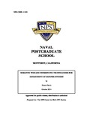
NPS Dissertation: AVCL mission vocabulary
Design, implementation and testing of a common data model
supporting autonomous vehicle compatibility and interoperability
Duane T. Davis, Naval Postgraduate School (NPS), September 2006
Abstract. Current autonomous vehicle interoperability is limited by vehicle-specific data formats and support systems. Until a standardized approach to autonomous vehicle command and control is adopted, true interoperability will remain elusive. This work explores the applicability of a data model supporting arbitrary vehicles using the Extensible Markup Language (XML). An exemplar, the Autonomous Vehicle Command Language (AVCL), encapsulates behavior-scripted mission definition, goal-based mission definition, inter-vehicle communication, and mission results. Broad applicability is obtained through the development of a behavior set capturing arbitrary vehicle activities, and automated conversion of AVCL to and from vehicle-specific formats. The former uses task-level behaviors suitable for mission scripting and goal decomposition. Translations use the Extensible Stylesheet Language for Transformation, XML data binding, context-free language parsing, and artificial intelligence machine learning and search techniques. Translation capability is demonstrated through mappings of AVCL to and from multiple vehicle-specific formats. A final demonstration of the power of a common autonomous vehicle data model is provided by the implementation of a hybrid control architecture. The model's vehicle-independence and the ability to generate vehicle-specific data are leveraged in the design of an architecture that provides increased autonomy by augmenting a vehicle's existing controller. The utility of this architecture is demonstrated through implementation on the Naval Postgraduate School's ARIES Unmanned Underwater Vehicle.
NPS Ph.D. Dissertation
Semantic Web Deep Dive

Slide 9
AVCL mission goals vocabulary (Davis 2015)
AVCL mission goals |  |  | Definition
Attack |  |  | To conduct a type of offensive action characterized by employment of firepower and maneuver to close with and destroy an enemy.
Decontaminate |  |  | To provide purification making an area safe by absorbing, destroying, neutralizing, making harmless, or removing chemical, biological, or nuclear contamination.
Demolish |  |  | To destroy structures, facilities, or material by any available means.
IlluminateArea |  |  | To provide locale lighting by searchlight or pyrotechnics.
Jam |  |  | To deliberately radiate, re-radiate or reflect electromagnetic energy with the object of impairing the use of electronic devices or systems.
MarkTarget |  |  | To make visible (by the use of light, infrared, laser, smoke, etc.) of an object in order to allow its identification by another object.
MonitorTransmissions |  |  | To conduct electronic warfare support operations with a view to searching, locating, recording and analyzing radiated electromagnetic energy.
Patrol |  |  | To gather information or carry out a security mission.
Rendezvous |  |  | Achieve a meeting at a specified time and place.
Reposition |  |  | To change position from one location to another.
SampleEnvironment |  |  | Collect environmental samples for testing for chemical compounds, biological creatures, or nuclear hazards.
Search |  |  | To look for lost or unlocated objects or persons.
14 different goal types
More
Goal Types Foreseen:
Supply
SpecialTask
(wild card)

Slide 10
Example AVCL Missions
Here we go… define task flow using those 14 types of goals

Slide 11
Your Steps for Creating AVCL Mission Plans
Sketch the mission concepts, including map or chart
Copy Visio template, draw logic for AVCL mission plan
Encode AVCL mission plan in XML, also validate syntax OK
Future storyboards: SPIDERS3D visualization, Microsoft Plan, etc.

Slide 12
Mission definition, step by step…
Your Steps rephrased in detail…
1. Define your mission understandably
Simple terminology for goals and steps, maps and diagrams are help
Then regularize goals using AVCL goal types
2. Draw mission workflow diagram (Visio suggested, or any other tool)
Sequenced list of goals, emphasizing paths for success
Paths for failure (alternative branching) or exception handling (usually abort)
Add constraints (boundary conditions, timing requirements, limitations, etc.)
Add risk elements deserving human oversight, how are they mitigated?
3. Create AVCL mission file (using XMLSpy editing tool, or any text editor)
Agenda list of goals, simply extend the template provided
Add, review descriptions and metadata throughout. Does it all make sense?

Slide 13
Coffee Search Retrieval Mission
Example mission design and encoding

Slide 14
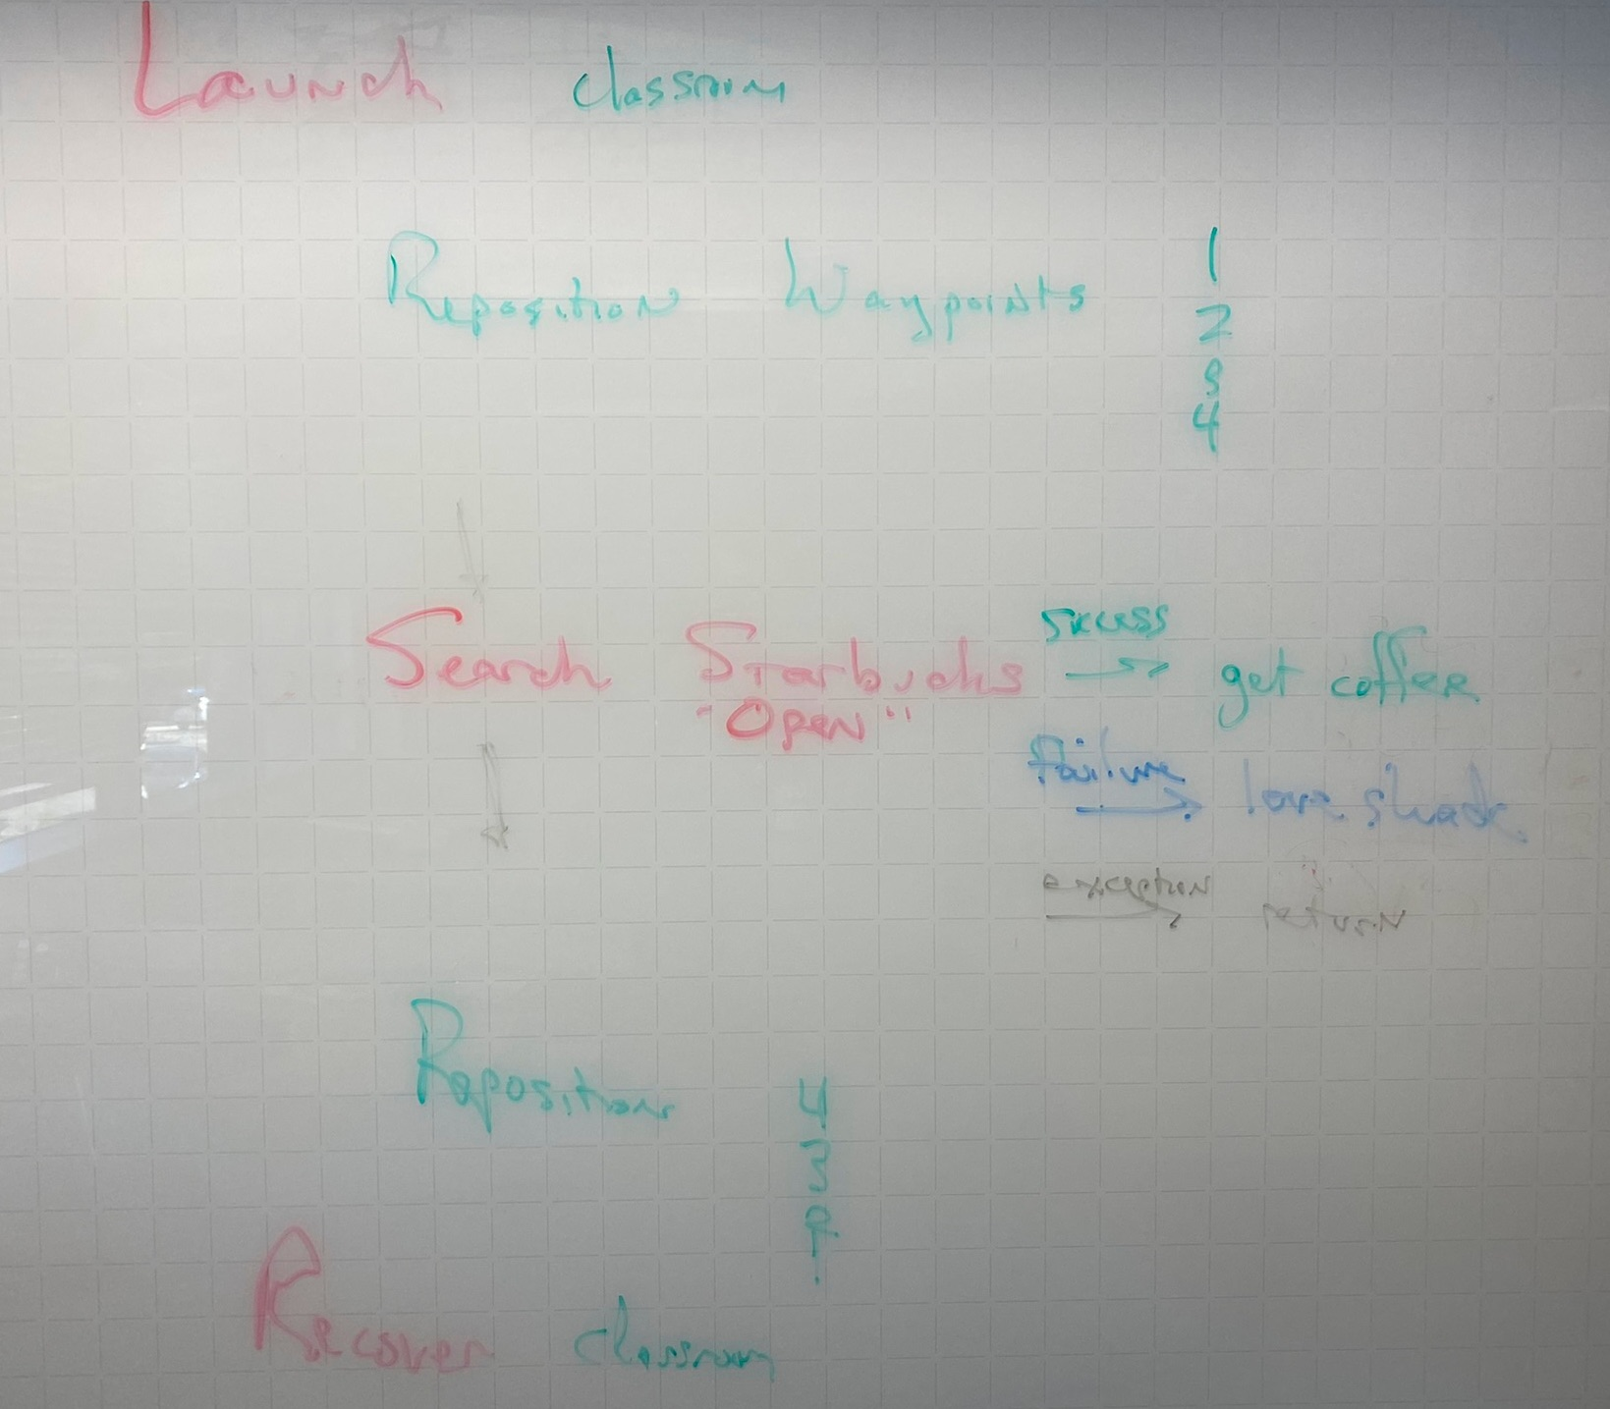
Coffee Search Retrieval Mission Goals, defined
Launch robot
Reposition
Waypoints 1, 2, 3, 4 as path to destination
Search
Starbucks open: RDVU resupply
else Cafe open: RDVU resupply
else no coffee available
Reposition
Waypoints 4, 3, 2, 1 as path returning back
Recover robot
Notes:
“love shack” = Chef Lovejoy’s Del Monte Café. This example originally devised as class effort 3 AUG 2022.

Slide 15
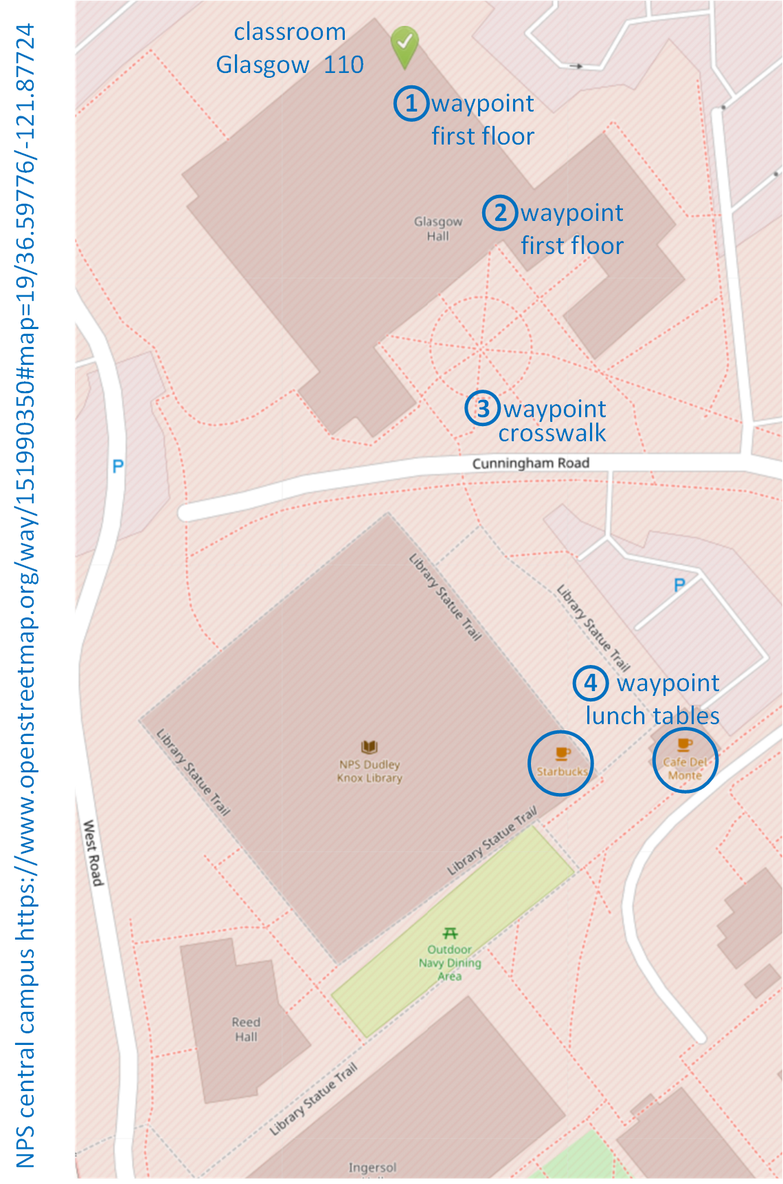
Coffee Search and Retrieval Mission, defined a little more precisely…
Start at classroom doorway
Safe path, altitude limits for human safety
Move to food courtyard
Waypoints 1, 2, 3, 4
If Starbucks is open, get coffee
Otherwise, if Cafe Del Monte open, get coffee
Otherwise, give up and return
Retrace steps back to classroom
Waypoints 4, 3, 2, 1
Notes:
https://www.openstreetmap.org/way/151990350#map=19/36.59776/-121.87724

Slide 16
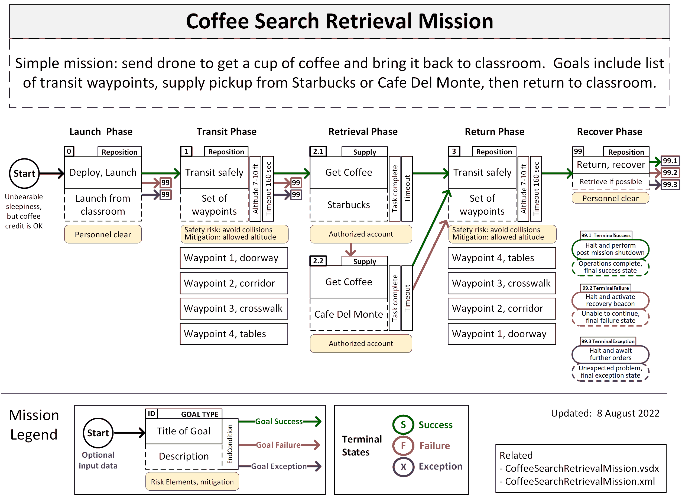
Coffee Search Retrieval Mission Diagram

Slide 17
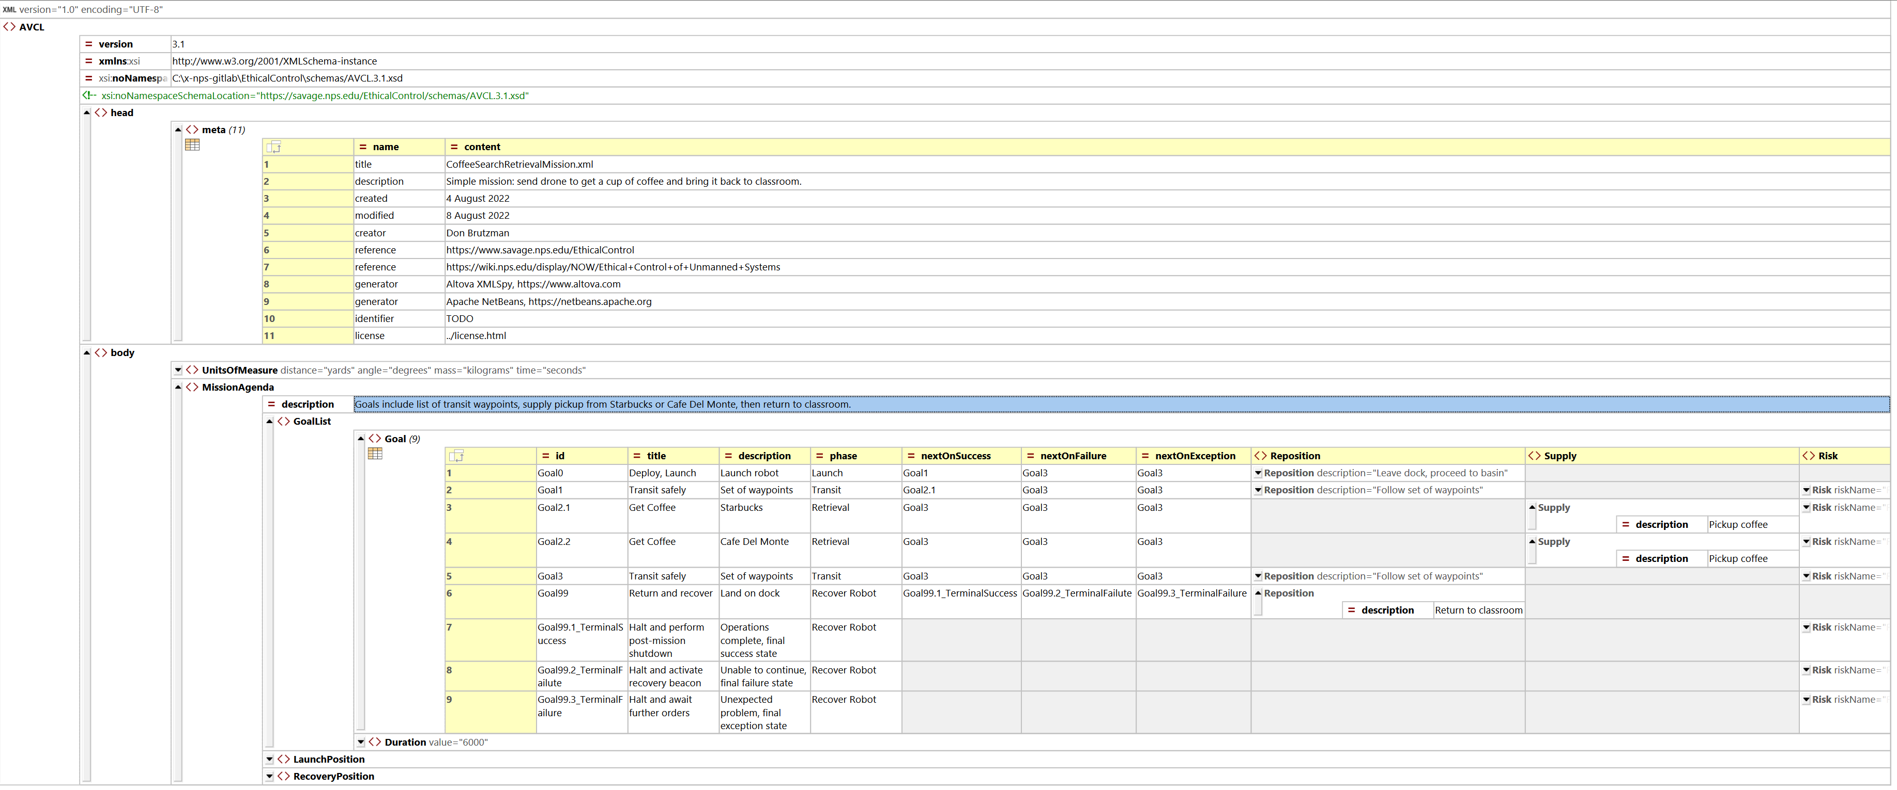
CoffeeSearchRetrievalMission.xml (using XMLSpy)

Slide 18
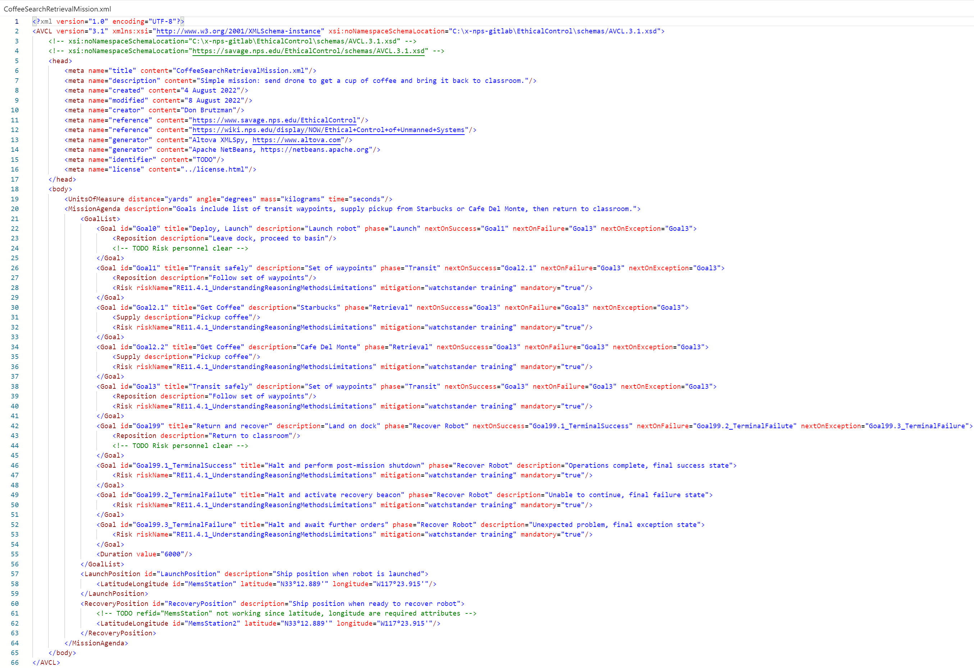
CoffeeSearchRetrievalMission.xml (plain-text XML view, identical)

Slide 19
NPS MEMS experimentation test TCE 22.2
Acoustics team led by Dr. Fabio Alves, NPS Physics Department

Slide 20
Mission objectives
Evaluate performance of MEMS acoustic vector sensor for detecting underwater and aerial vehicles or targets.
Record acoustic signature of several sources
(e.g., UUVs, ROVs, Boats, UAVs, UAS, etc.)
Evaluate capability of determining bearing to targets and measuring how accurate are the bearings.
Compare sensor-provided bearings with actual (controlled experiments)
Evaluate the survivability of the sensors in the field
Air and Underwater

Slide 21
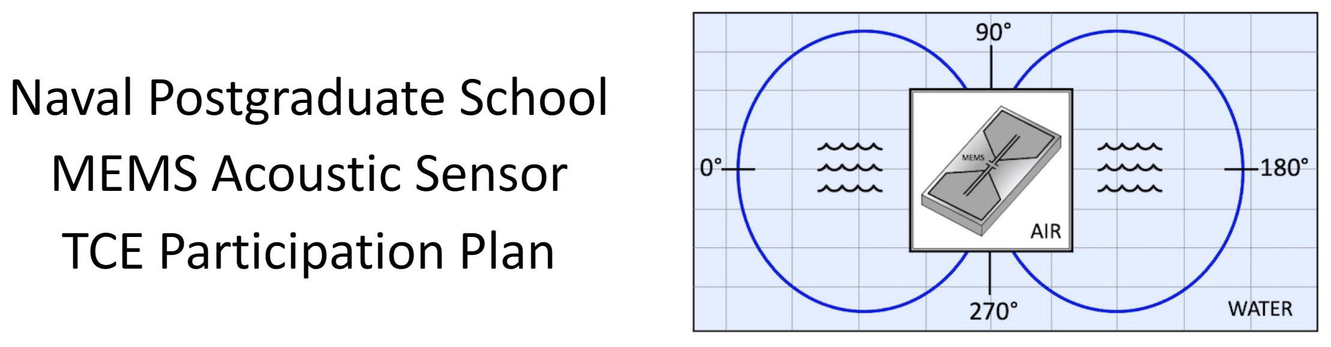
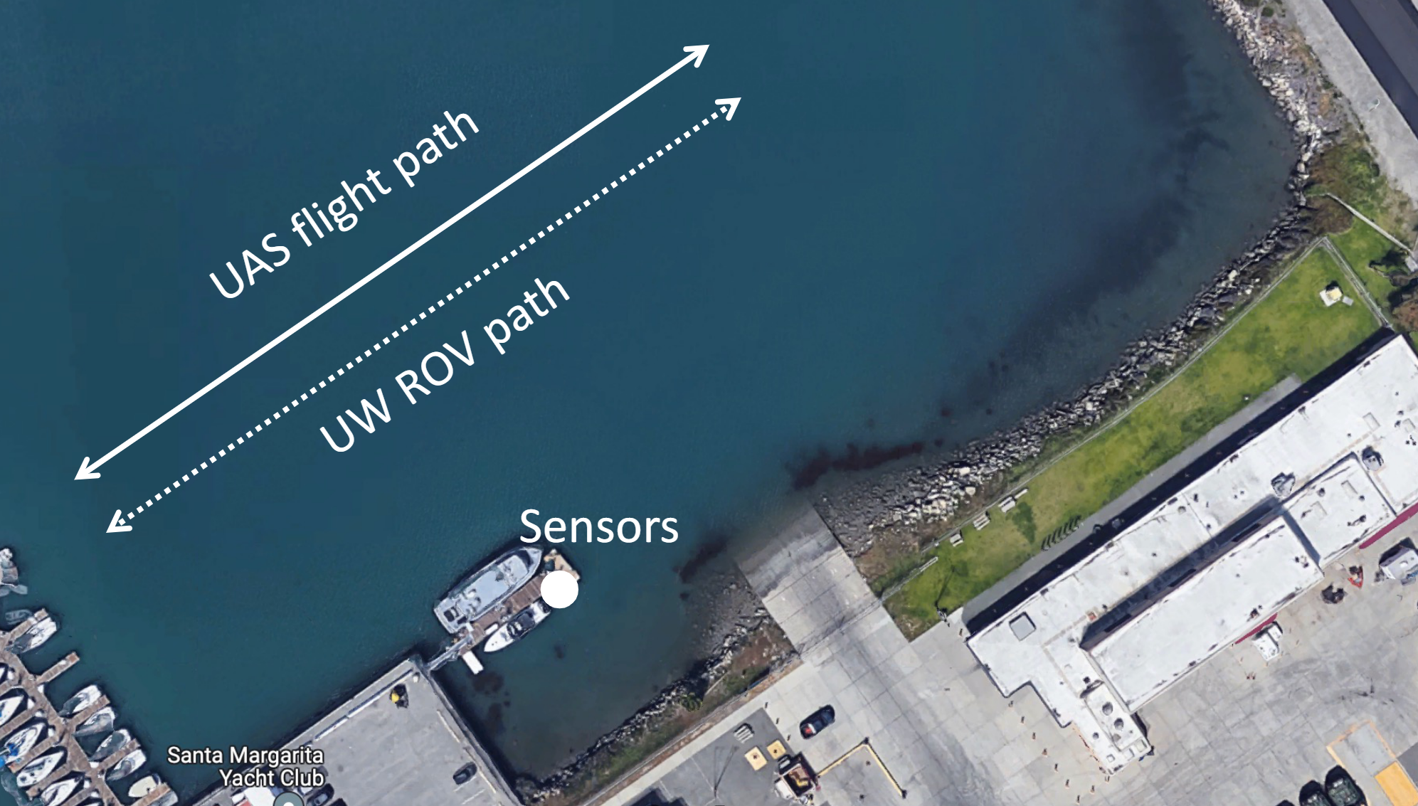
NPS MEMS Experimental Setup

Slide 22
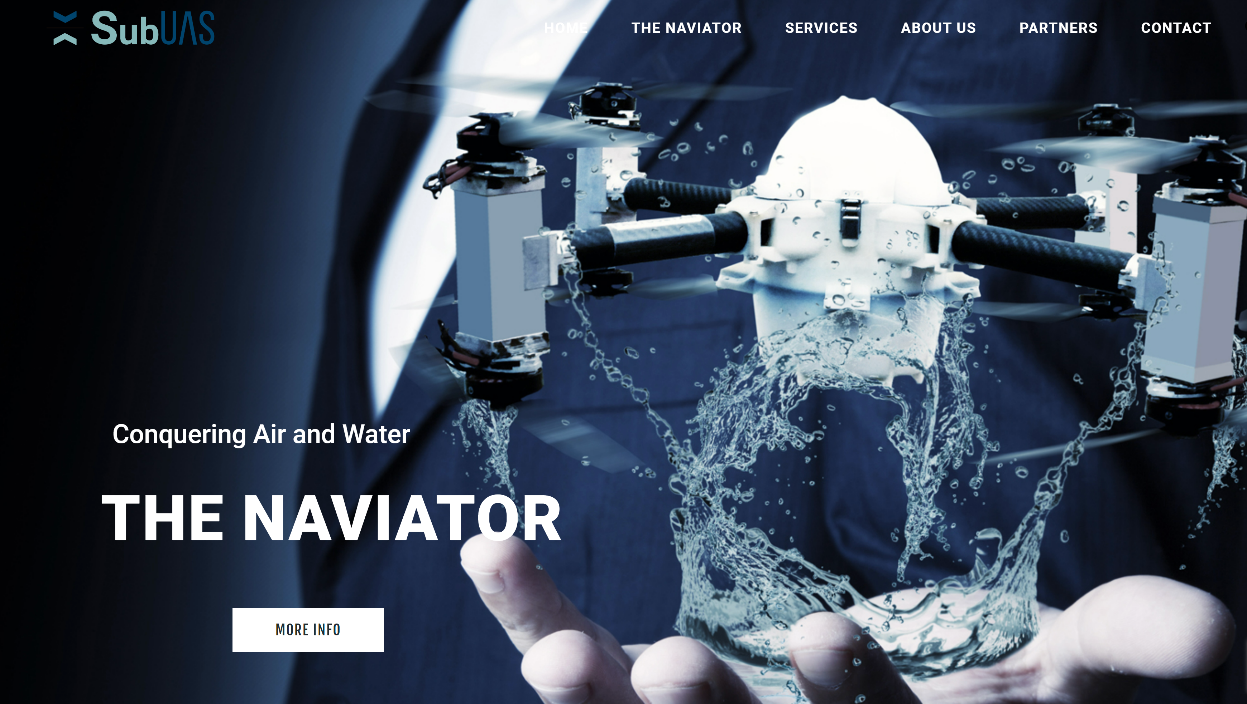
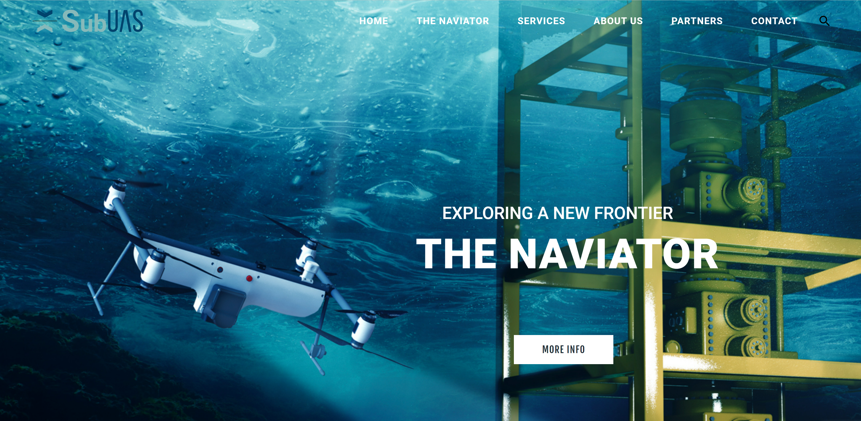
Naviator SubUAS
Single robot able to provide acoustic signals for tracking and testing
SubUAS can both fly and swim submerged
https://thenaviator.com

Slide 23
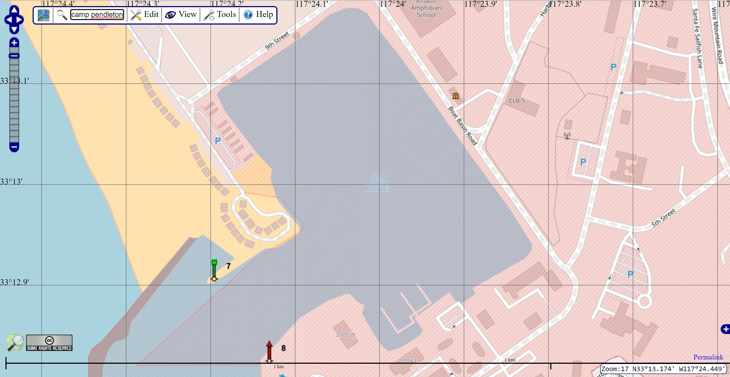
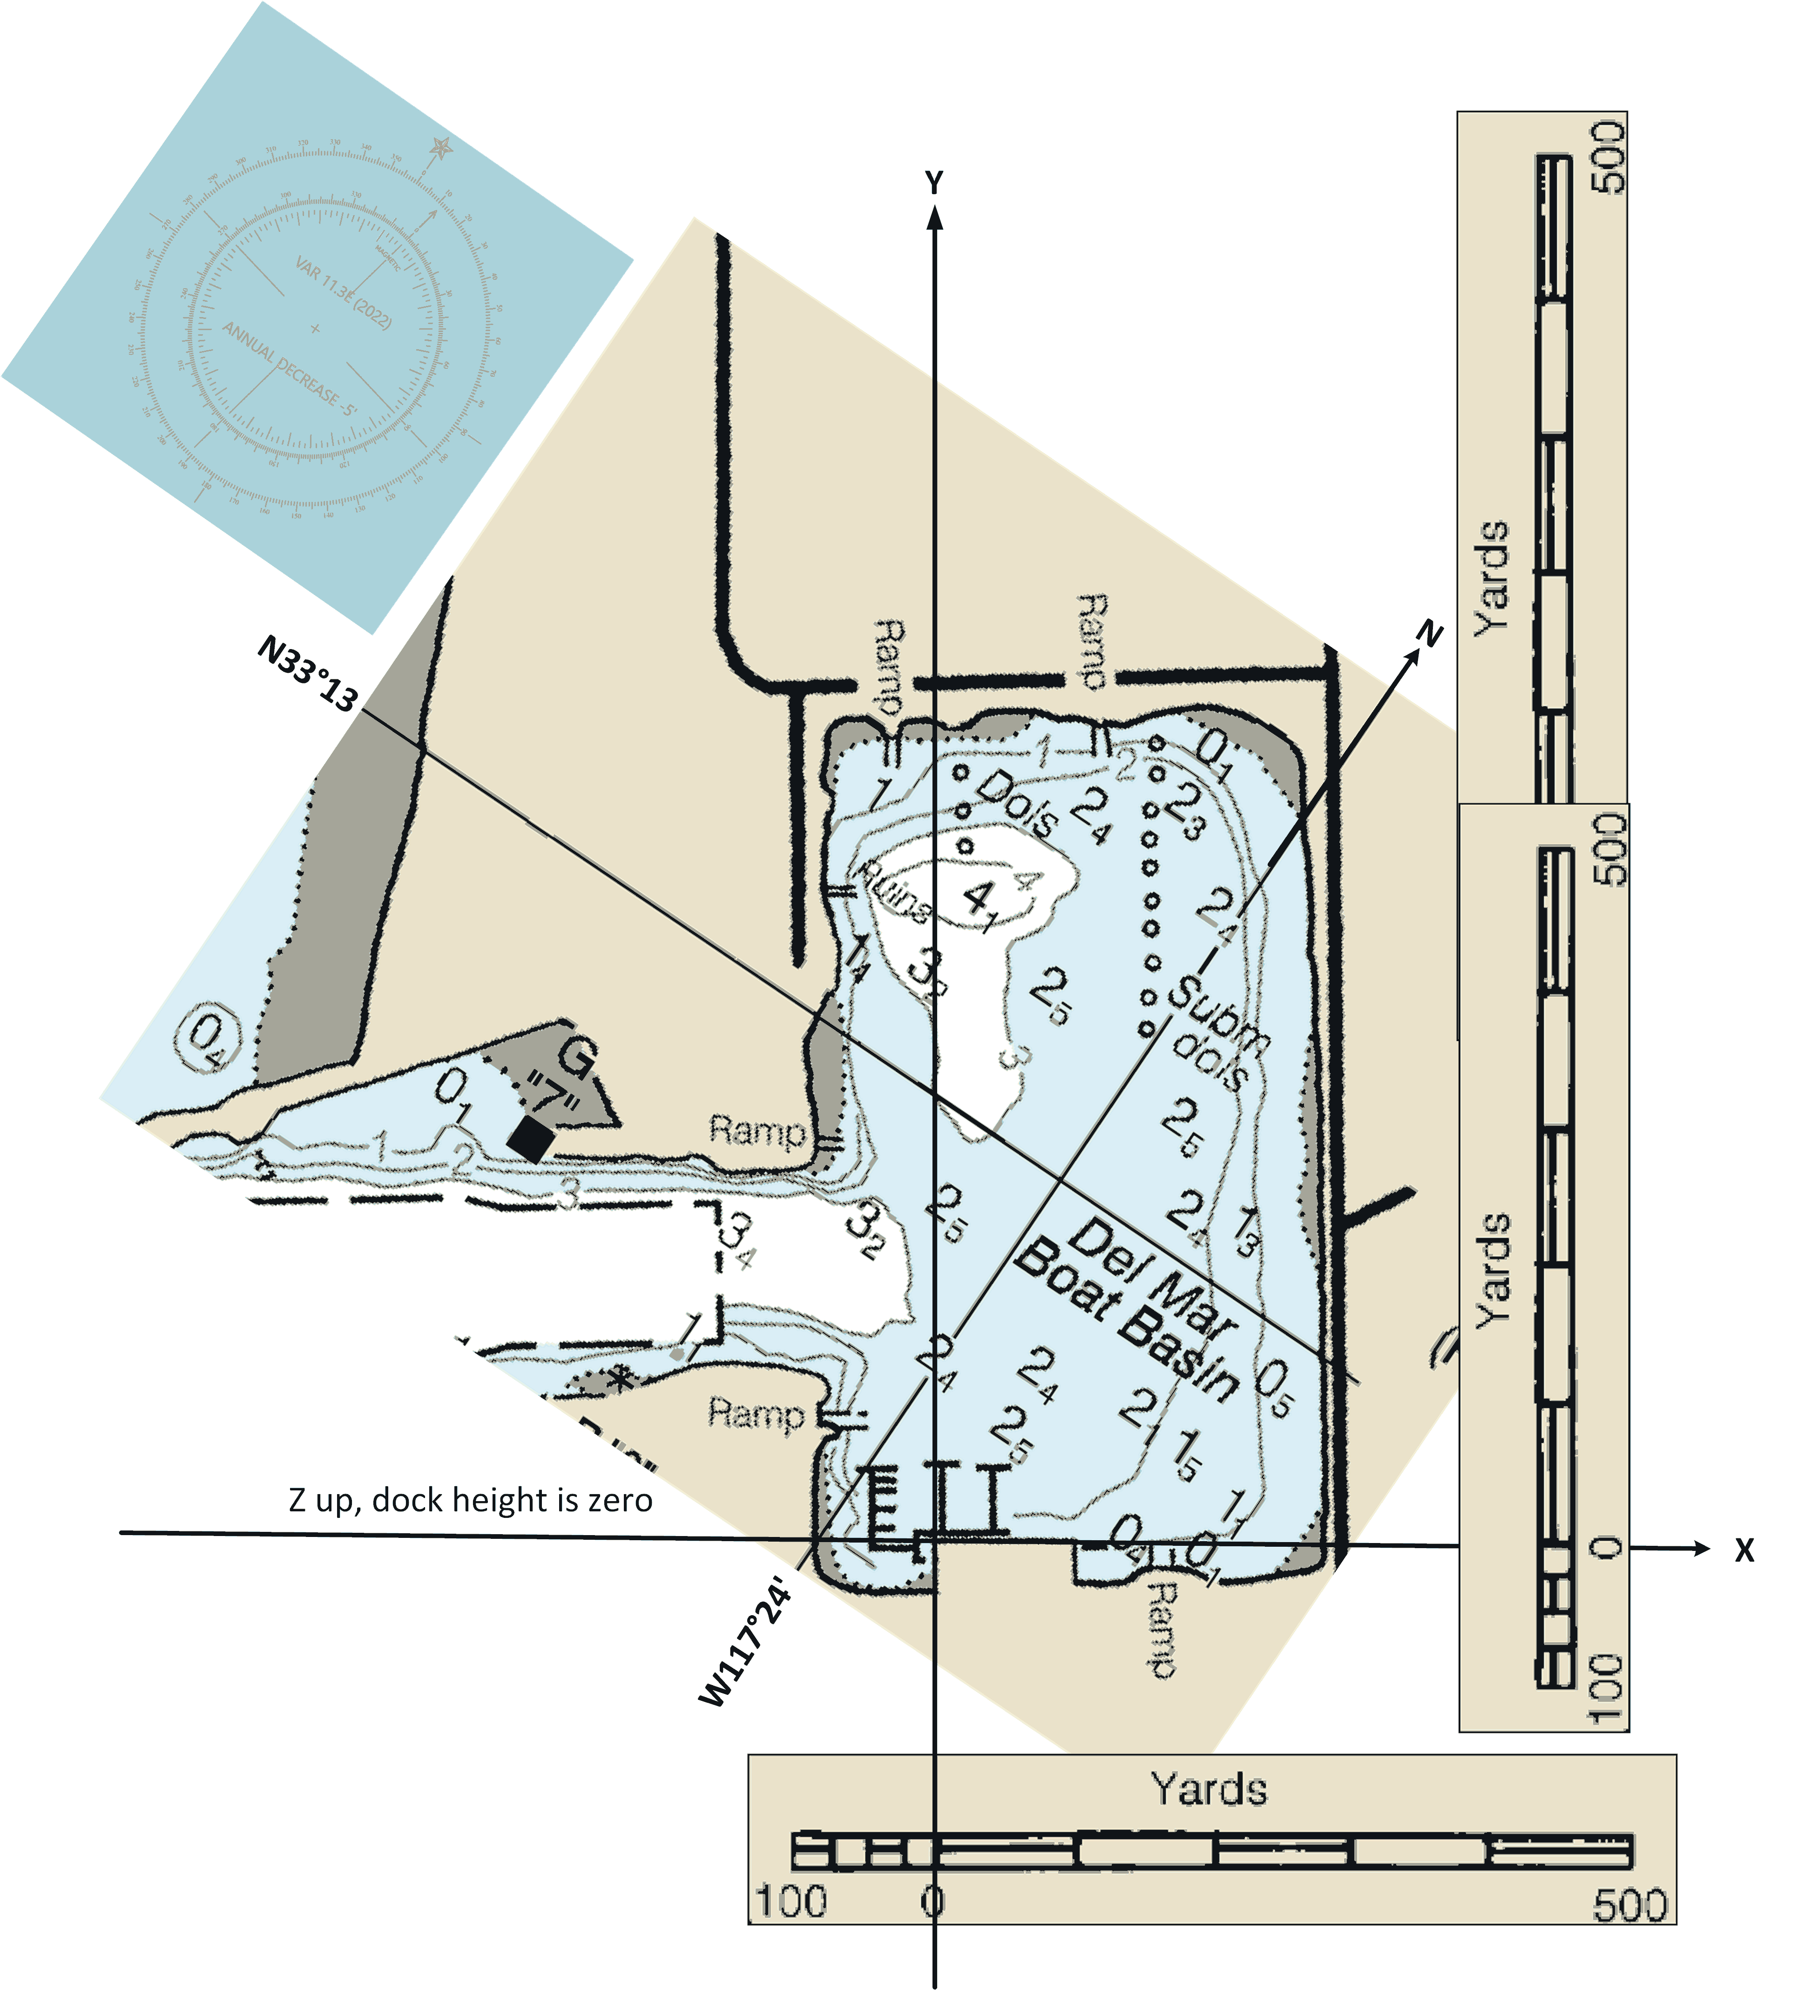
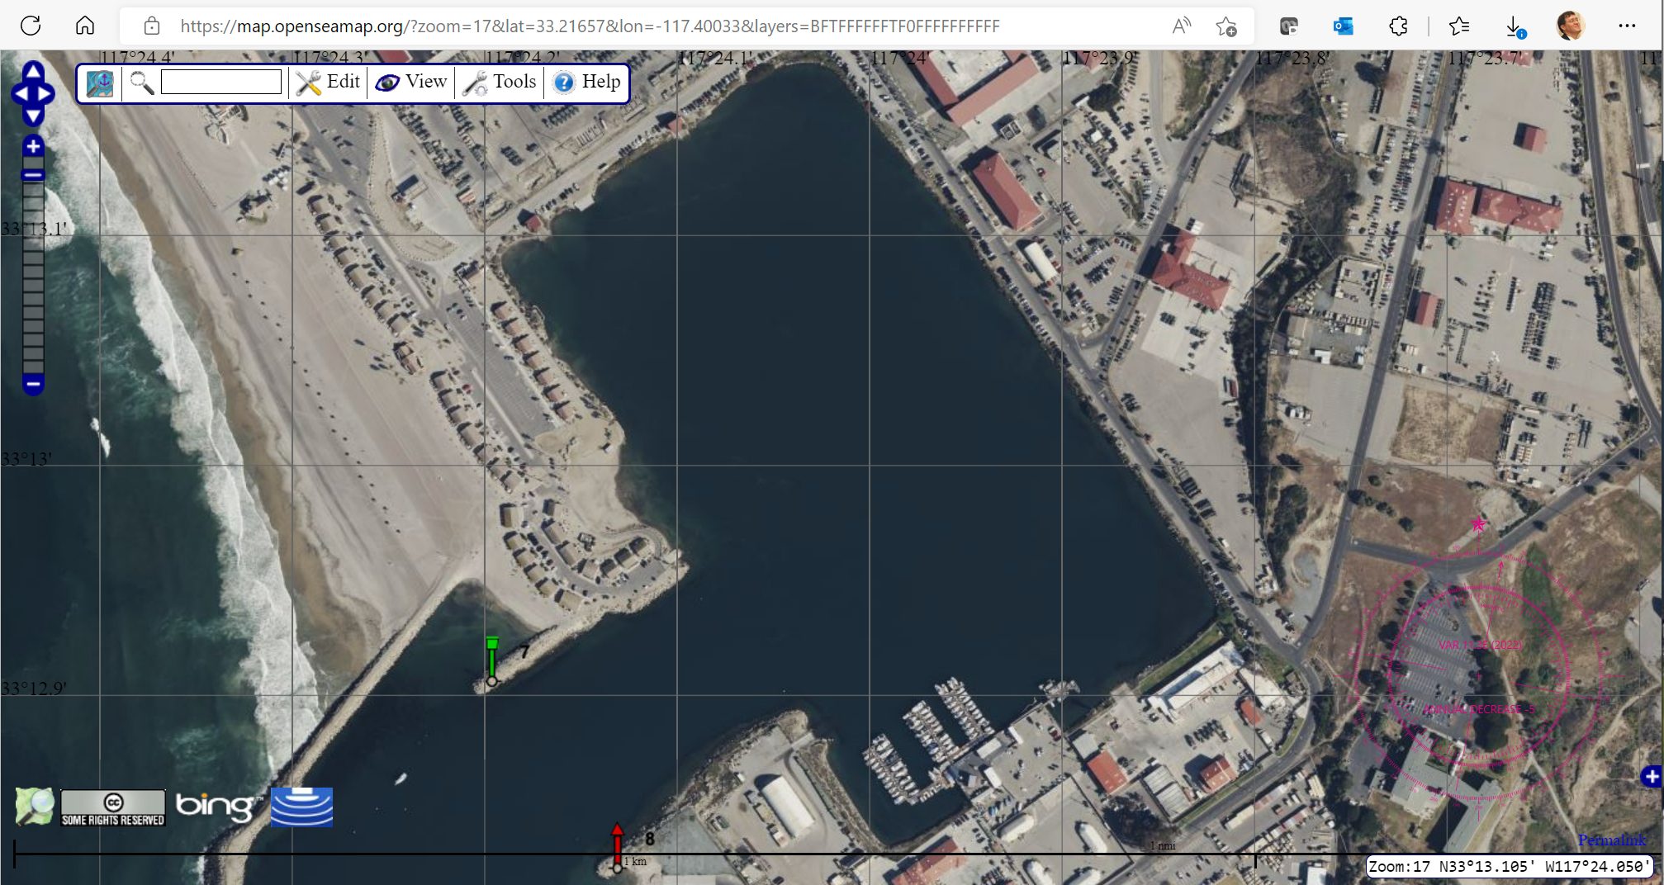
Chartlets for Camp Pendleton Delmar Boat Basin, NPS MEMS Test
Candidate local coordinate system

Slide 24
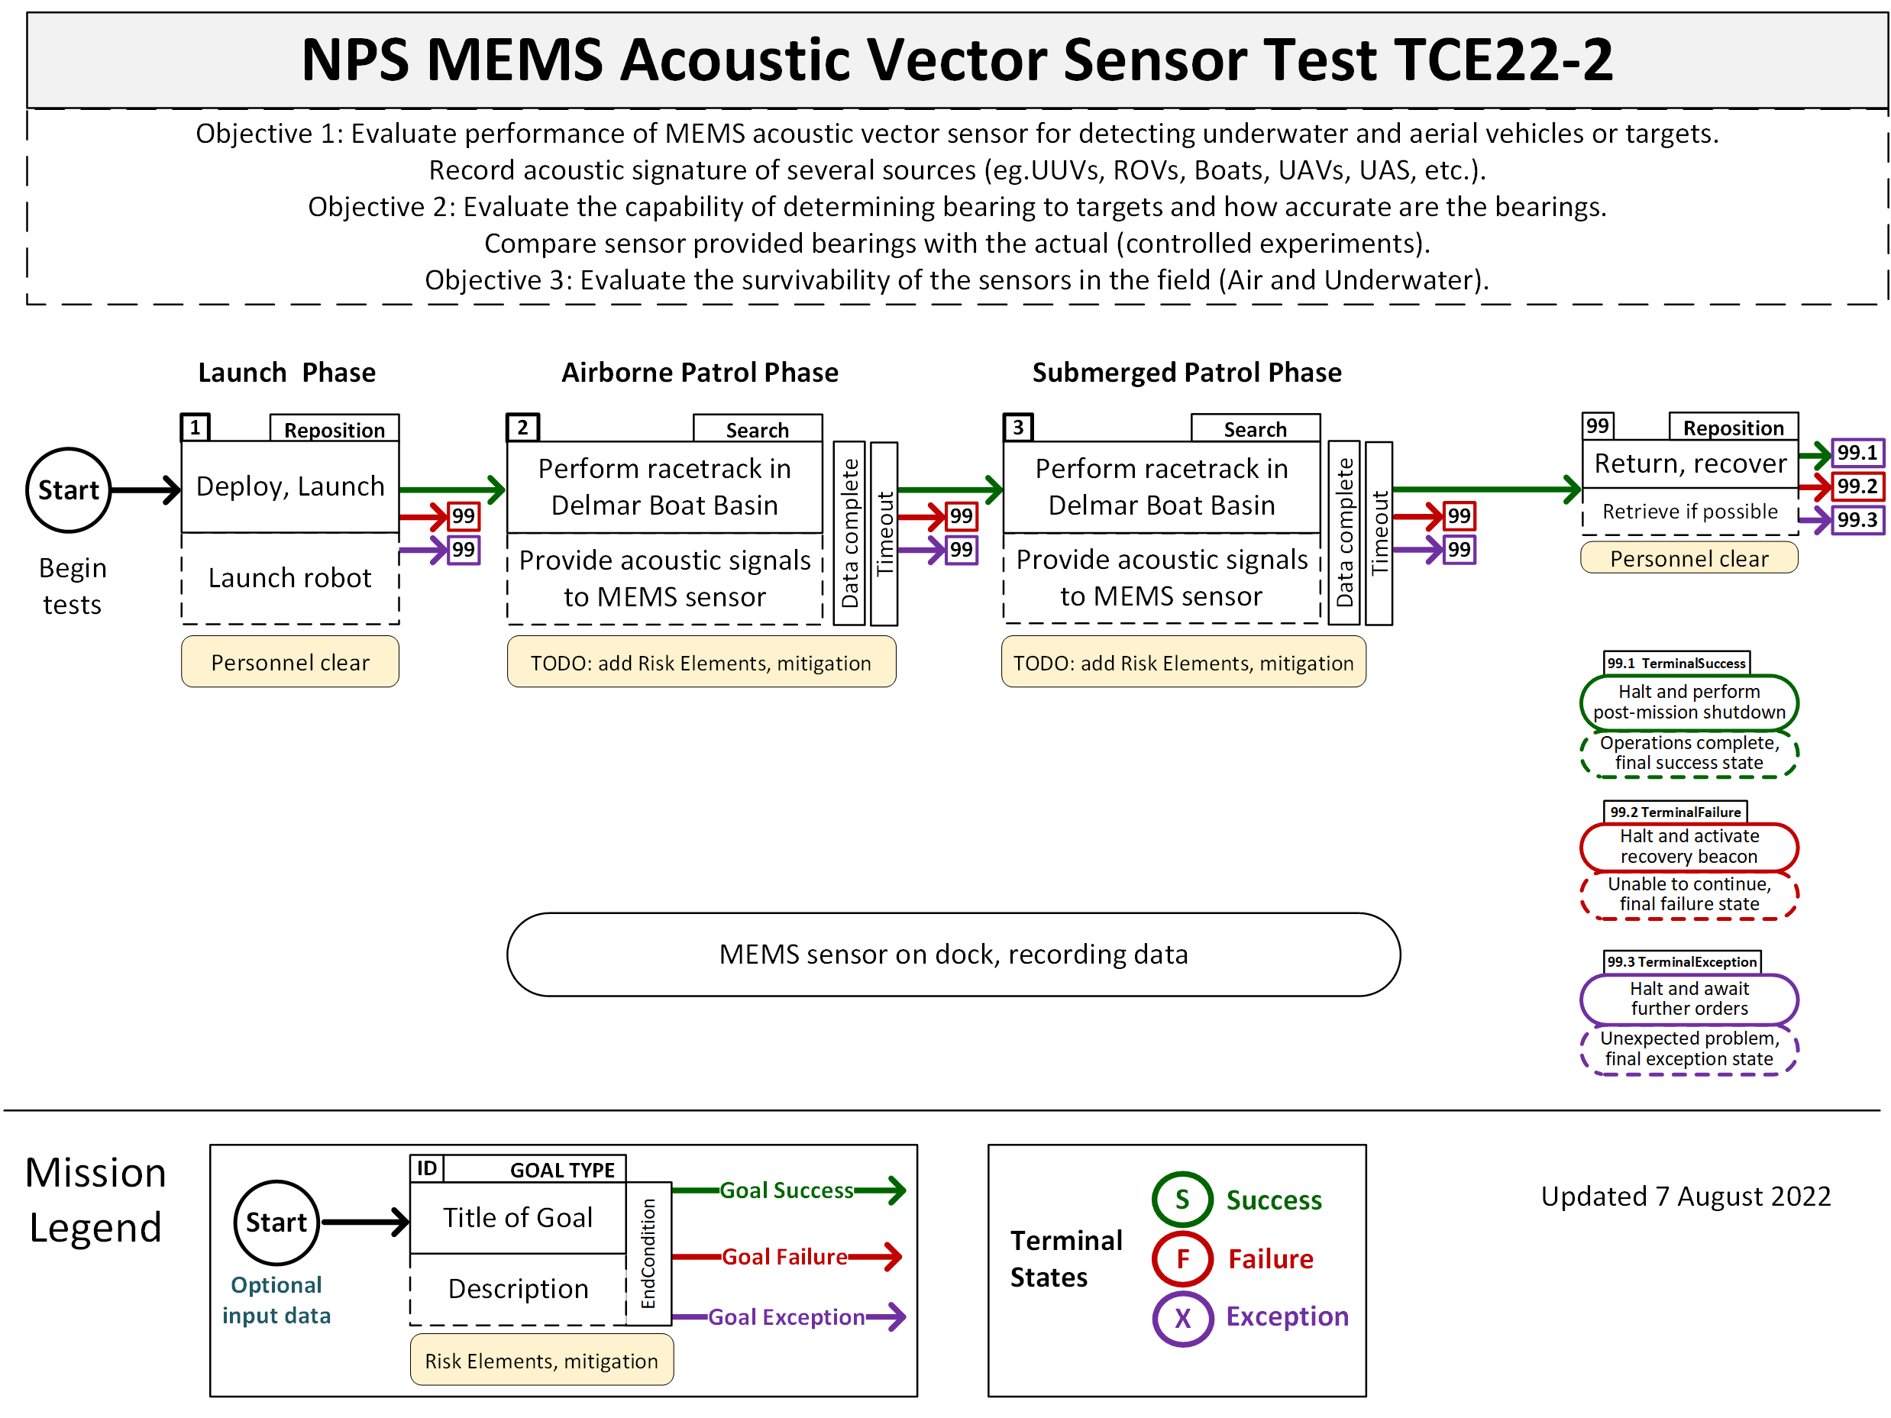
TCE22-2MemsAcousticVectorSensorTesting.png

Slide 25
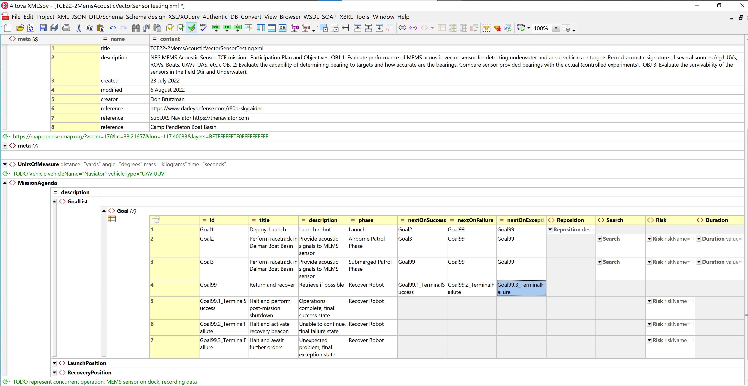
TCE22-2MemsAcousticVectorSensorTesting.xml (using XMLSpy)

Slide 26
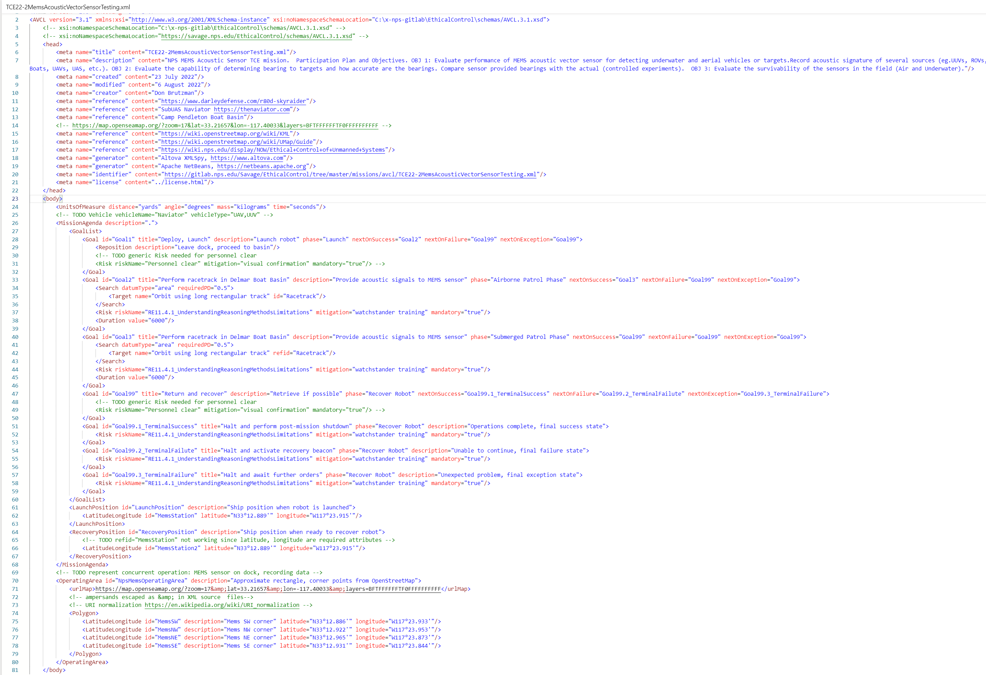
TCE22-2MemsAcousticVectorSensorTesting.xml (plain-text XML view, identical)

Slide 27
Templates to build new missions
Copy, rename, modify Visio and XML documents for preparing your own missions

Slide 28
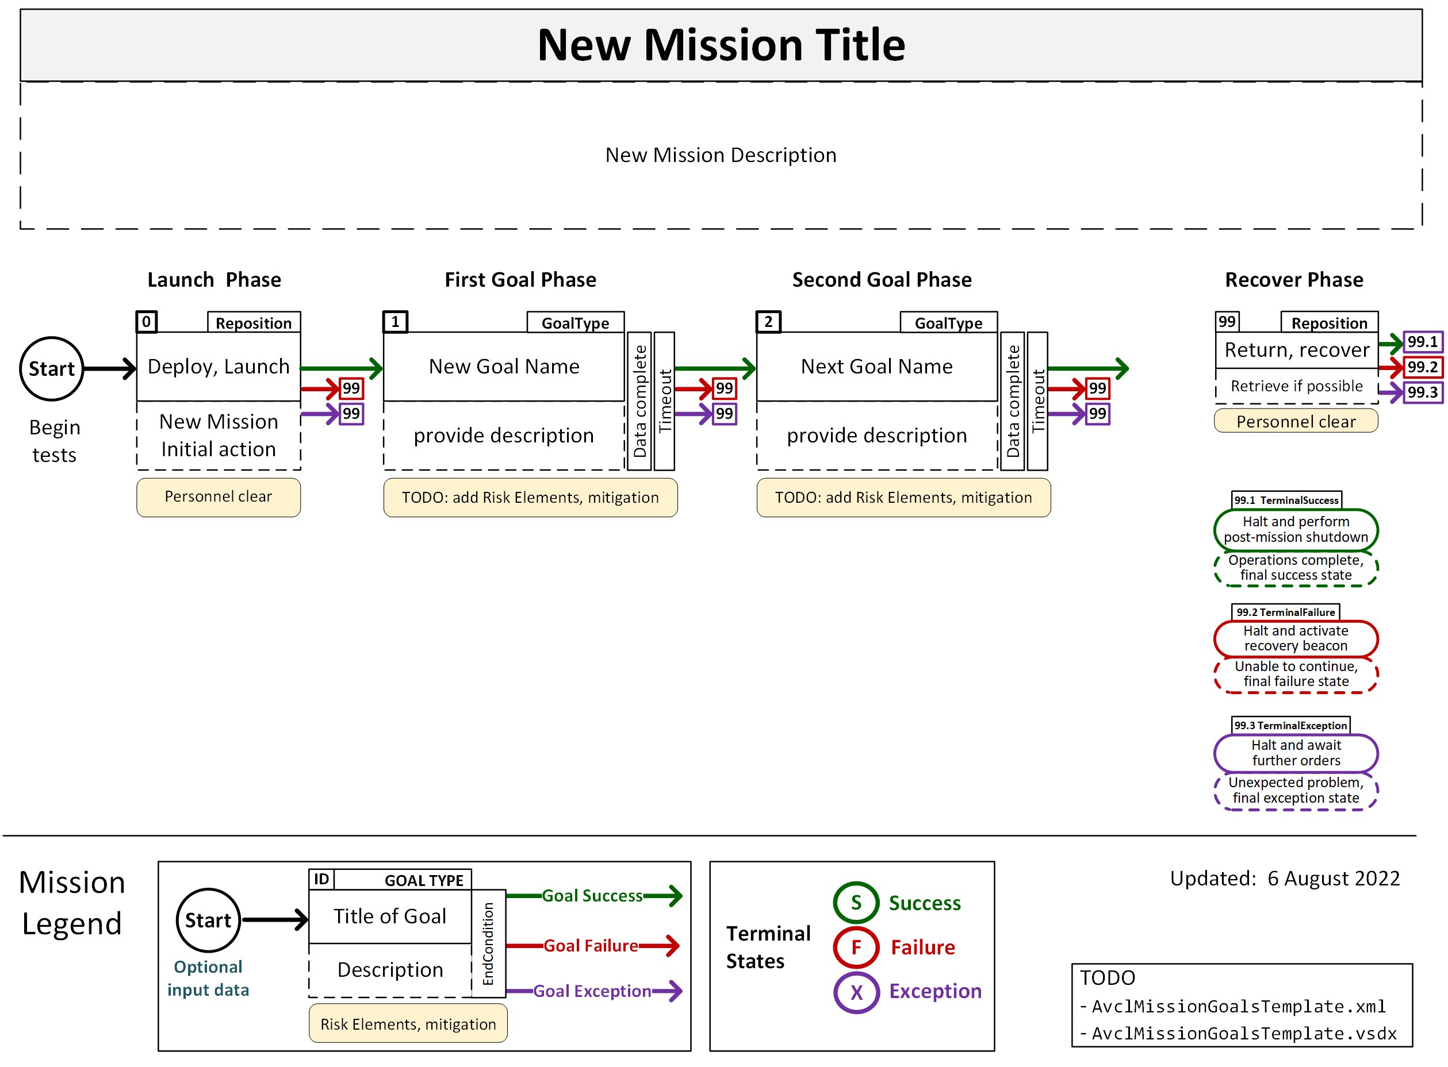
AvclMissionGoalsTemplate.xml

Slide 29
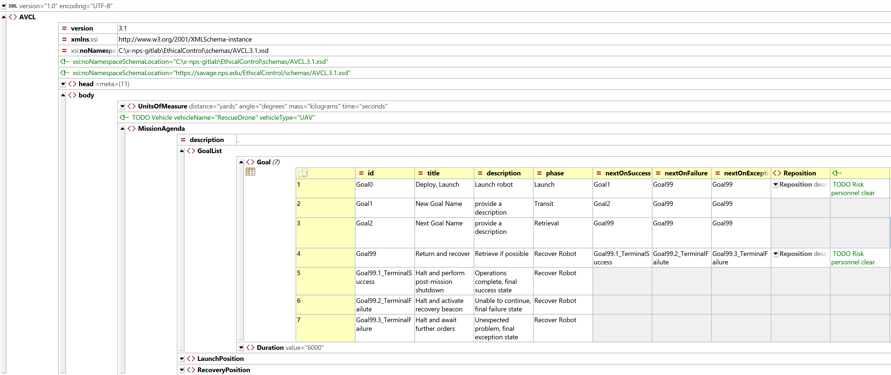
AvclMissionGoalsTemplate.xml

Slide 30
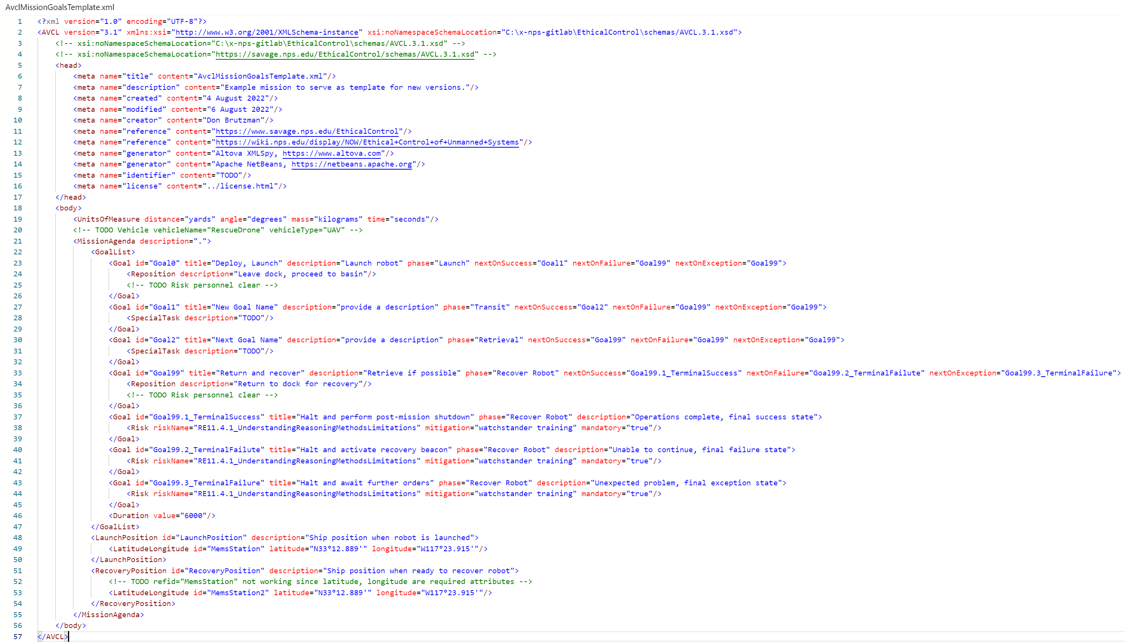
AvclMissionGoalsTemplate.xml

Slide 31
Ready, set, go
Putting pieces together, build presentation showing course assignment

Slide 32
Prepare new robot missions! Tell your story!
Each team should prepare two or more missions for their project:
Test mission being pursued by experimental partner
Candidate mission that might be useful to your warfare community
After JIFX: adding Risk Elements, human mitigations to mission goals
Focus on concepts and precise expressiveness… I can help you “dial in” your document syntax and semantics of the XML representations to pass validation checks. These will be excellent tests of AVCL expressive power.

Slide 33
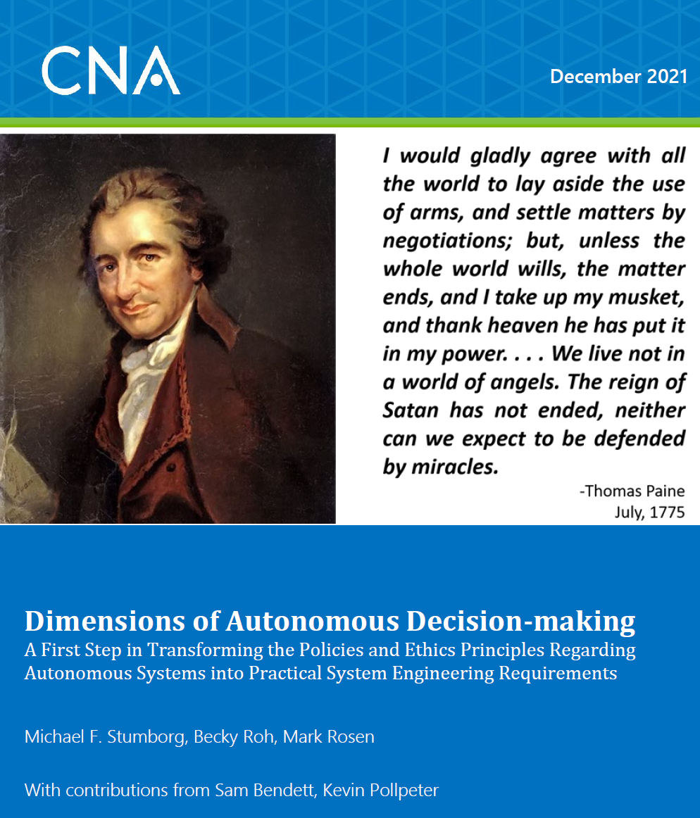
Next step: adding risk elements, mitigations for deliberate human control of autonomy
Given several well-defined real-world robot missions, how can we ensure human commanders have good context, thus able to direct proper checkpoints and permissions for ethically controlled autonomous operation?
CNA Dimensions of Autonomous Decision-Making (DADM) offers grounded, precise semantic definitions we can use
Define AVCL Risk Elements and corresponding mitigations in (yellow-box) constraints for each mission goal…
Follow precepts of Ethical Control of Unmanned Systems

Slide 34
Looking ahead: future work
Assess vocabulary and risks that define robot tasks in order to build tests,
Ethical Control of Unmanned Systems,
SPIDERS3D visualization to evaluate mission conduct

Slide 35
What can you say? What can’t you say?
Testing vocabulary with real-world examples is important
Identifying missing terms or ambiguities is also important
Expect we are building testable exemplars for future use
Achieving clarity helps operators, TTPs, mission effectiveness

Slide 36

Ethical Control of Unmanned Systems
Premise. Ethical control of unmanned systems can be accomplished through structured mission definitions that are consistently readable, validatable and understandable by humans and robots.
Principle. Responsible humans must remain in charge of lethal/lifesaving force, and then human-robot teams become more effective.
Precept. Well-structured mission orders can be syntactically and semantically validated to give human commanders confidence that offboard systems
will do what they are told to do, and further
will not do what they are forbidden to do.
https://savage.nps.edu/EthicalControl

Slide 37
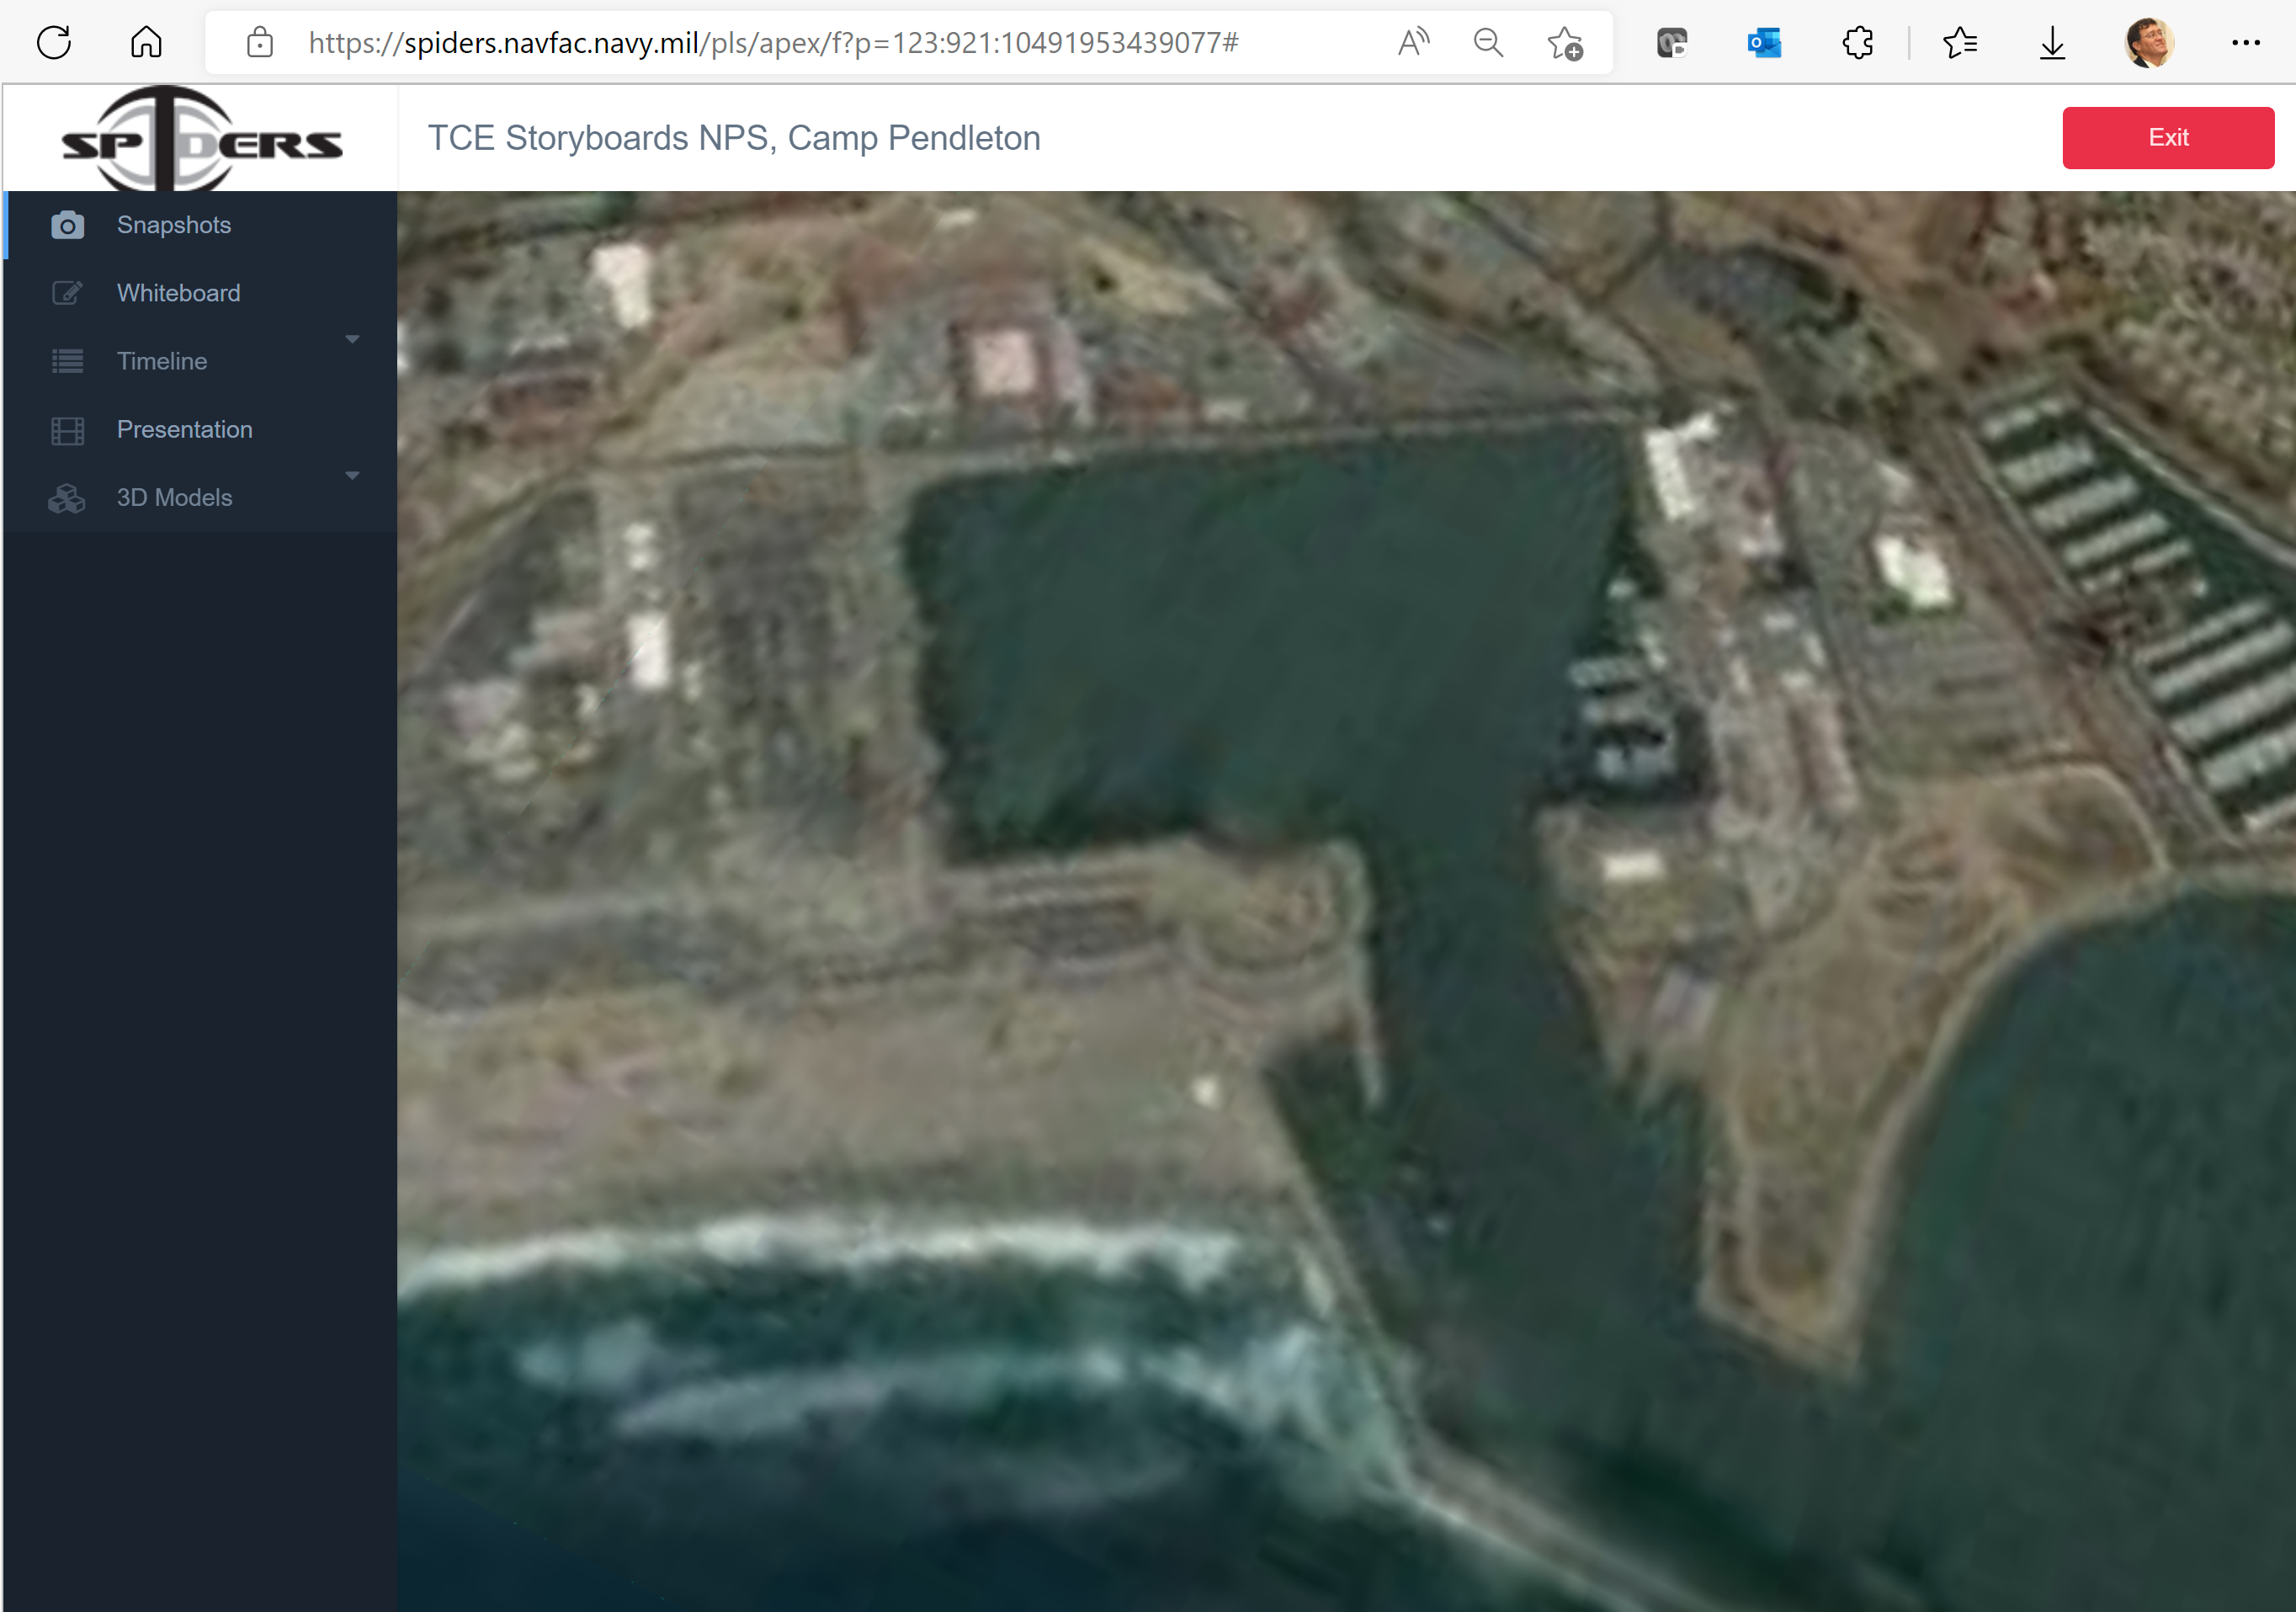
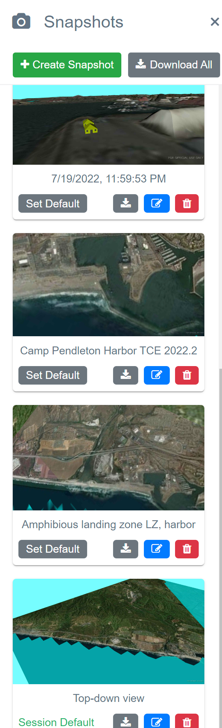
Future capabilities: SPIDERS3D visualization
https://spiders.navfac.navy.mil (requires CAC and account)
https://gitlab.nps.edu/Savage/Spiders3dPublic and Spiders3dCUI)

Slide 38
Contact
Don Brutzman
brutzman@nps.edu
http://faculty.nps.edu/brutzman
Code USW/Br, Naval Postgraduate School
Monterey California 93943-5000 USA
1.831.656.2149 work
1.831.402.4809 cell
Notes:
Questions and feedback are always welcome. Thanks for considering the possibilities.

